Slide 1
FINAL Presentation
Team-11
Ds 5500
Members:
Pratik Dahibhate
Mitanshi Vyas
Rivana Christie

Slide 2
02
Zillow real estate price forecasting
(Time Series Forecasting)

Slide 3
Introduction
House prices and rental home prices changes from year to year depending on various factors and human activity pattern
By having a means to predict or estimate the price and the rent helps to give a clear perspective to people who are potentially looking to buy or rent houses as well as invest in the real estate market

Slide 4
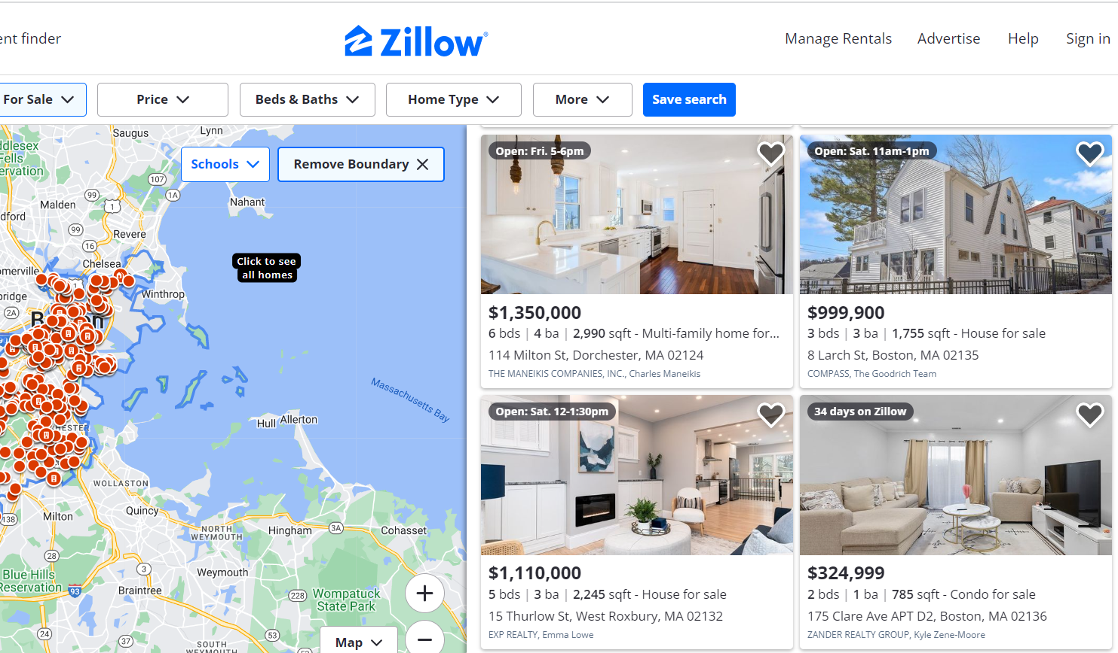
Dataset
Zillow’s Research Dataset Website
https://www.zillow.com/research/data/
Housing Value and Rental Dataset
Features Include:
RegionID
SizeRank
RegionName
RegionType
StateName
State
City
Metro
CountyName

Slide 5
methodology
Data Preprocessing
Hyper-parameter Tuning
Step-1
step-3
step-2
step-4
Implementation of forecasting models
Comparison of ML Model’s Performance

Slide 6
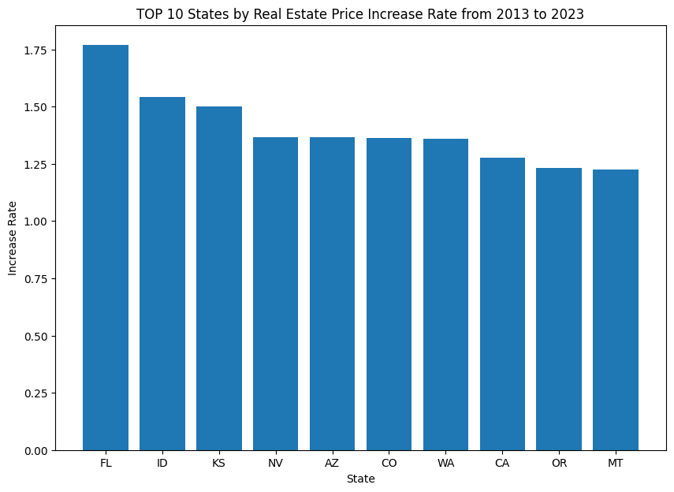
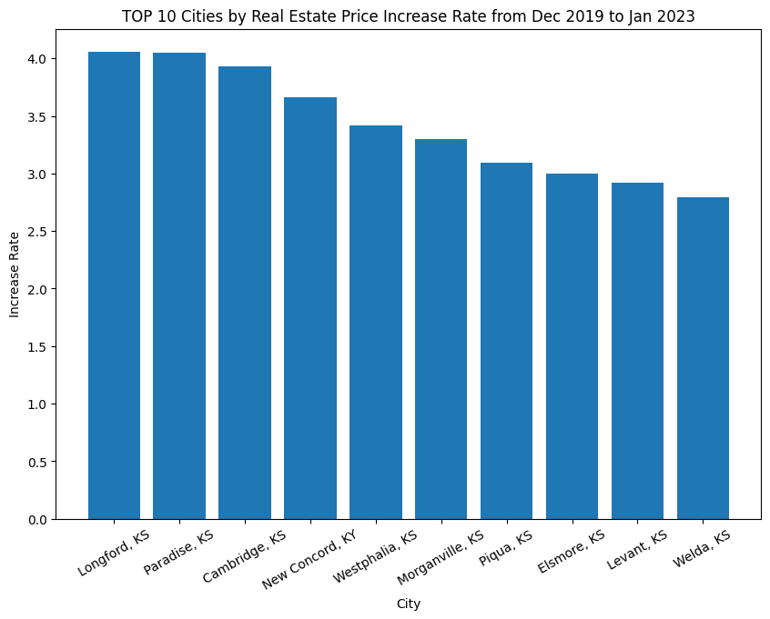
Low Level Risk - EDA
ROI - 5 Years 2018 - 2023
ROI - 10 Years 2013- 2013
Price Increase from 2000 - 2023
Price Change During Covid 2019 - 2023

Slide 7
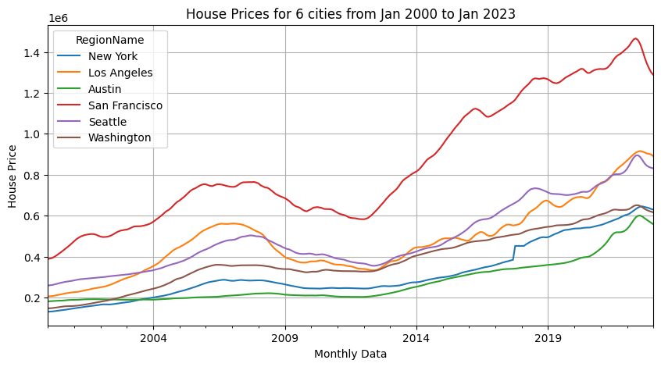
6 Metropolitan Cities were selected to see the trend in the house prices
and then use the subset for forecasting model
New York
Los Angeles
Austin
San Francisco
Seattle
Washington
Data Preprocessing:
A subset was selected for each given city.
The subset was melted and transposed, so the dates can be treated as index.
Train and Test sets were created from the transformed dataset.

Slide 8
ARIMA Modelling
ARIMA stands for Auto Regressive Integrated Moving Average
Parameters are :
p : Lag order
d : Degree of Differencing
q : Order of moving average
Used TSA Model library for creation of ARIMA Model
Determined the RMSE values for the forecasted results to measure the performance of the model.

Slide 9
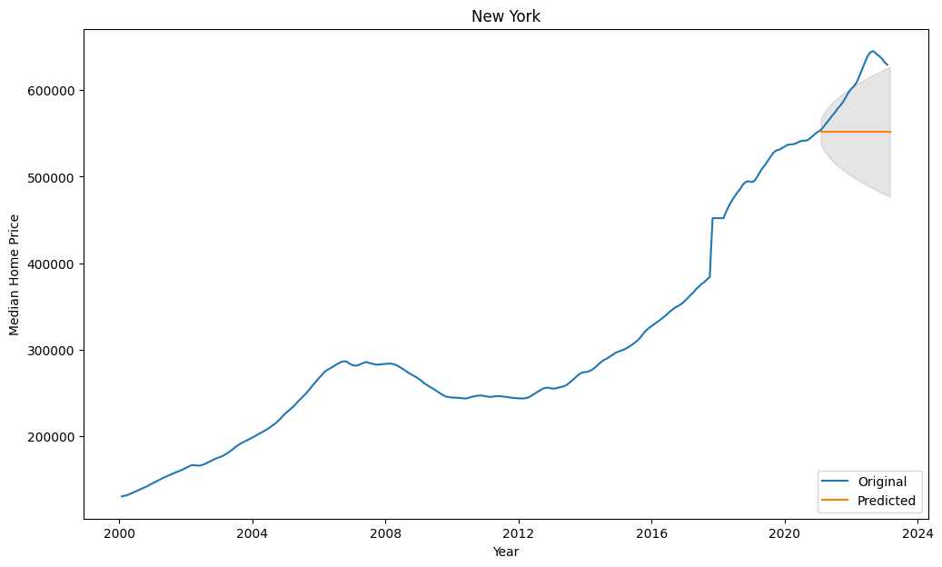
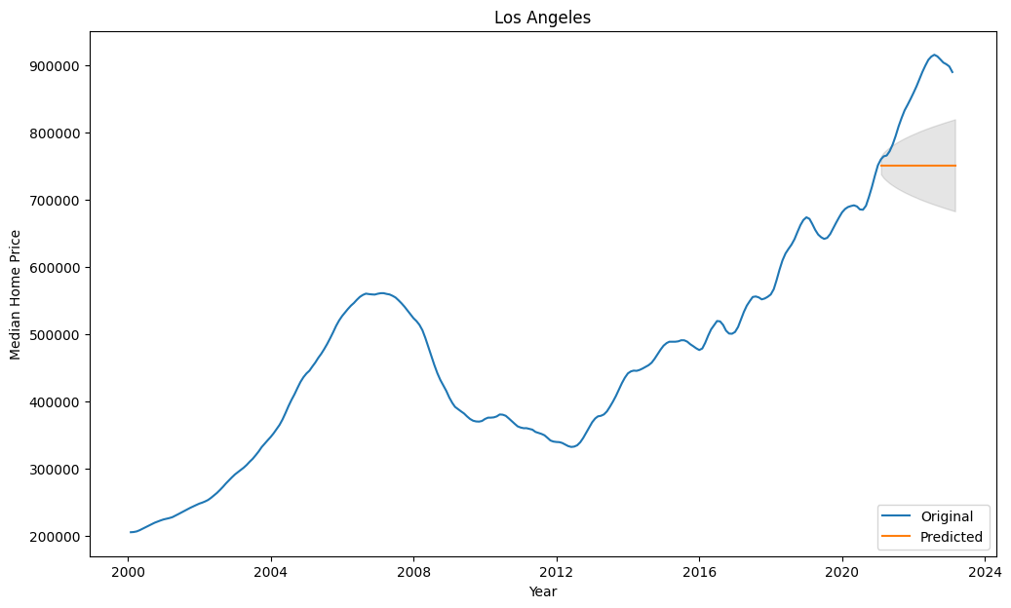
ARIMA Model Forecast for Cities of New York and Los Angeles

Slide 10
Medium Level Risk -SARIMAX Modelling
SARIMA stands for Seasonal Auto Regressive Integrated Moving Average
Parameters are :
p : Lag order
d : Degree of Differencing
q : Order of moving average
P : Seasonal autoregressive order
D : Seasonal difference order
Q : Seasonal moving average order
Used PMDARIMA library for creation of SARIMAX Model
Determined the RMSE values for the forecasted results to measure the performance of the model.

Slide 11
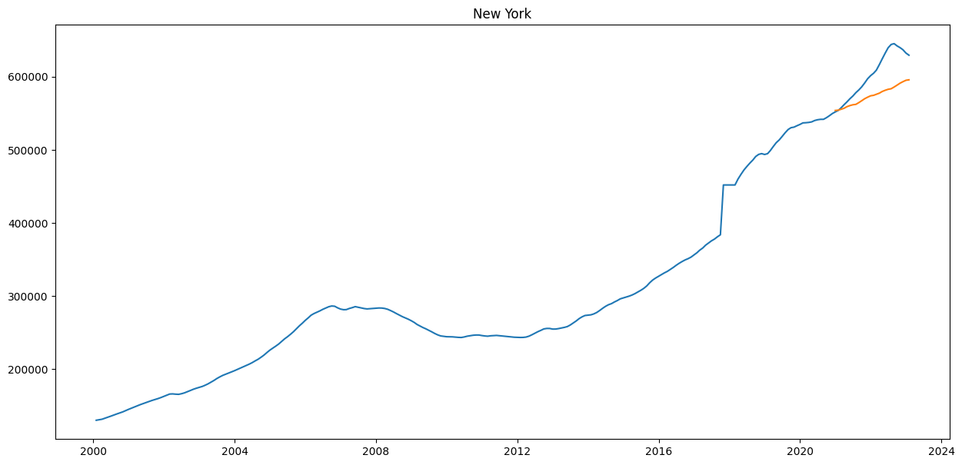
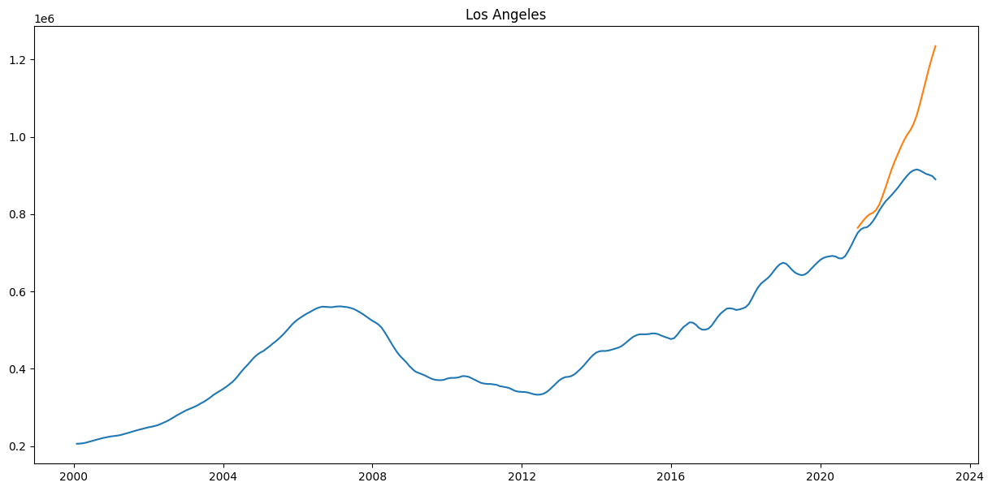
SARIMAX Model Forecast for Cities of New York and Los Angeles

Slide 12
PROPHET Modelling
PROPHET is a procedure for forecasting time series data.
It is a open source software released by Facebook’s team.
It is based on additive model where nonlinear trends are fit with yearly, weekly and daily seasonality, plus holiday effects.
Used prophet library for creation of model for forecasting results.
Determined the RMSE values for the forecasted results to measure the performance of the model.

Slide 13
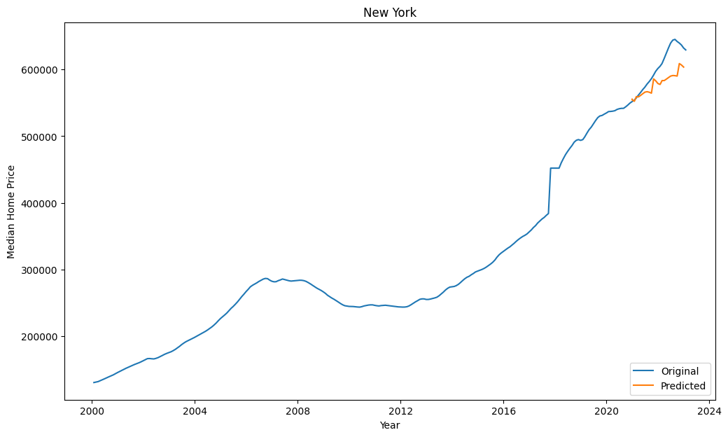
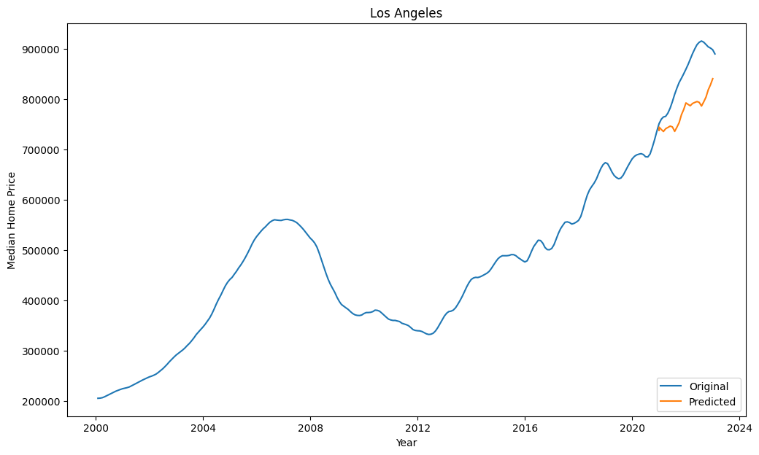
Prophet Model Forecast for Cities of New York and Los Angeles

Slide 14
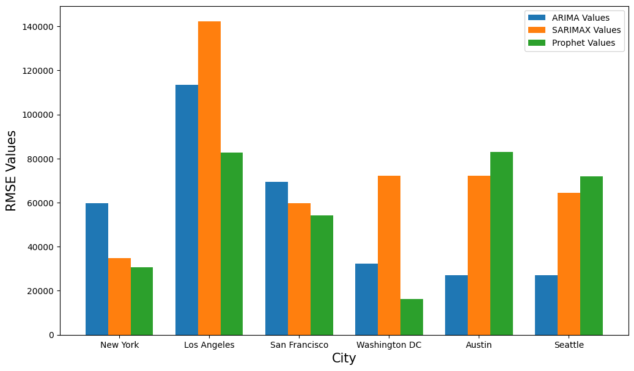
High risk assessment - Hyperparameter tuning & model comparison
Performed hyperparameter tuning on the three models in order to improve the predictions
For the ARIMA and SARIMAX models, implemented hyperparameter tuning on the parameters p, d and q using grid search in the auto arima function
For the Prophet model, defined the parameter grid and selected the best parameters based on the RMSE of the predictions given by that model
Compared the RMSE values for the three models for each city and visualized them using a bar chart
ARIMA and SARIMAX have higher RMSE values, whereas Prophet has low or average values for RMSE

Slide 15
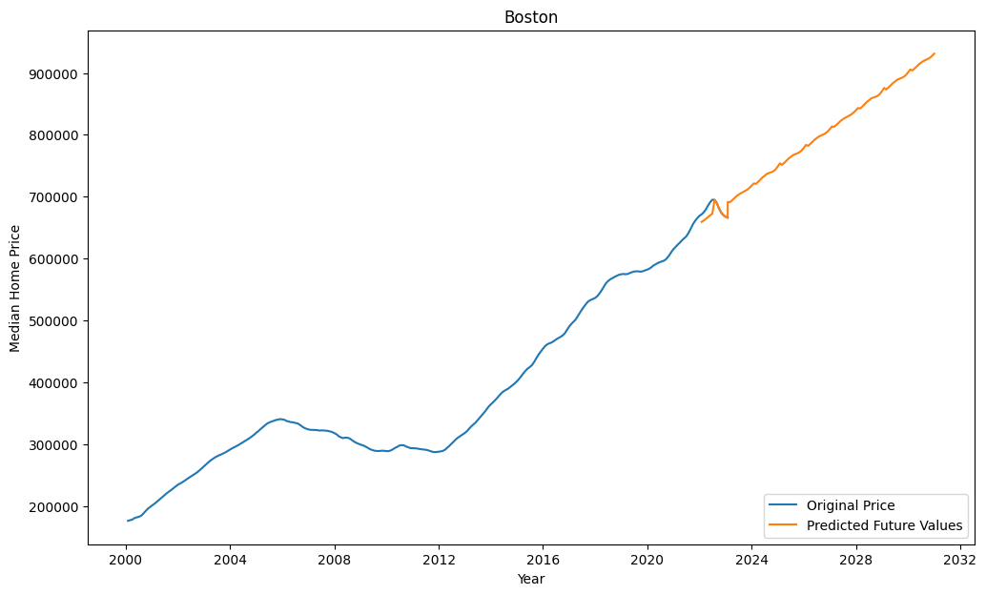
High risk assessment - Predict future house prices
Implemented a function that would predict the house prices till 2032 for a given city using the Prophet model
Utilized the ‘holiday’ parameter to define the current housing market crash occurring since July 2022

Slide 16
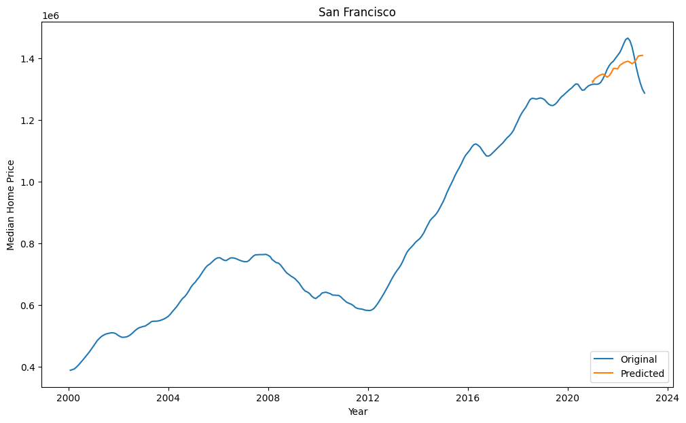
Failure
Currently, the housing market in the US is undergoing a market correction, with an increase in mortgage rates and decline in house prices
This occurrence could not be predicted by the model solely based on the house price data provided. Hence, we can consider this an example of a failure

Slide 17
conclusion
Housing market in the US is directly or indirectly affected due to various other occurrences in the economy
Explored some time series analysis models like ARIMA, SARIMAX and Prophet
Prophet model gave the best results and relatively low RMSE scores
Also implemented a function that predicts future house prices for a given city in the US
While the predictions that these models gave were not entirely accurate, they do give a brief estimate of the projected house prices in different cities across the country
This information can be utilized by potential home buyers as well as investors to make informed decisions when they plan to buy a house

Slide 18
Thank YOU!

